Slide 1


Towards Secure and Dependable Authentication and Authorization Infrastructures
Diego Kreutz, Alysson Bessani, Eduardo Feitosa, Hugo Cunha
PRDC2014, Singapore

Slide 2
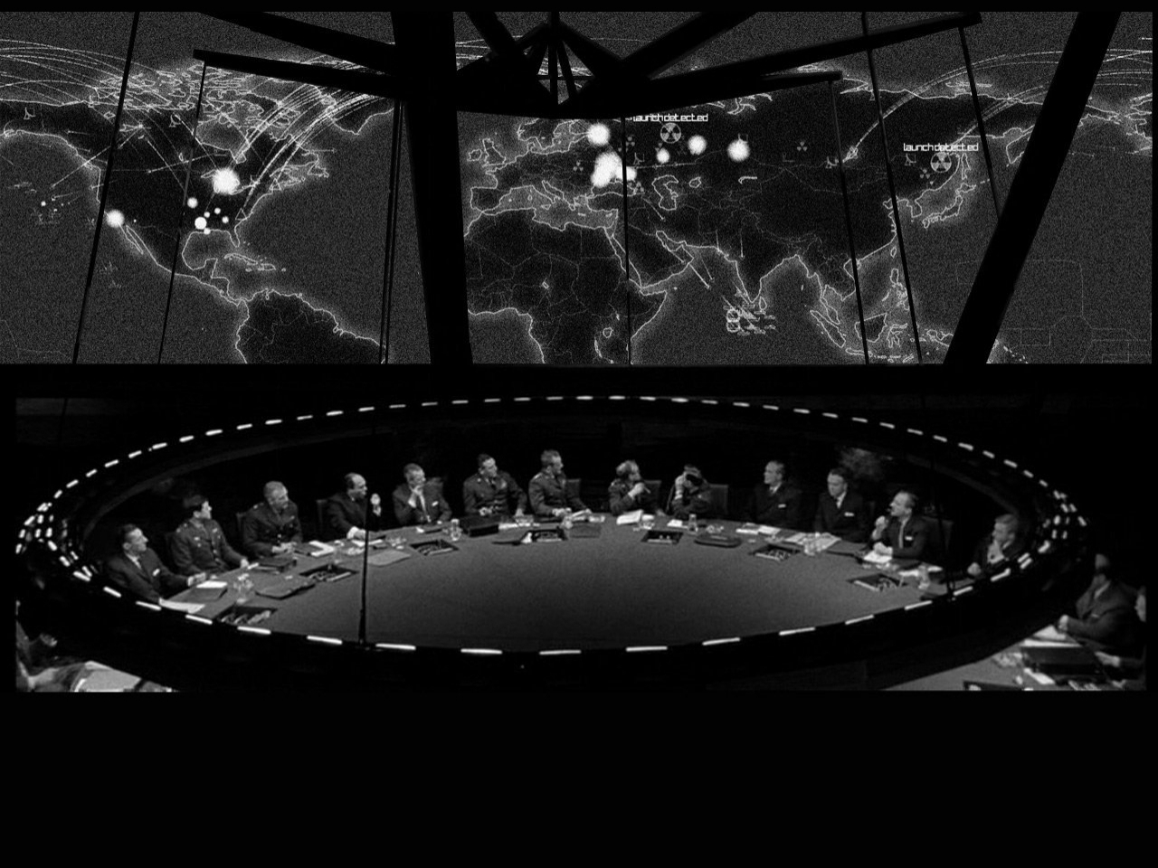

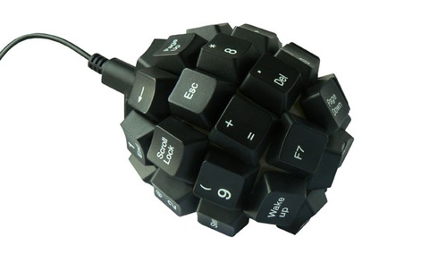
Cyber threats: state of affairs
NSA Director Rogers Urges Cyber-Resiliency
Threat Post, Washington, D.C. (United States)
Presidential Proclamation:
Critical Infrastructure Security and Resilience Month, 2014 The White House, Washington, D.C. (United States)
Biggest ever cyber security exercise in Europe today
European Commission - PRESS RELEASES, October 30, 2014
Survey: Cyber security priorities shift to insider threats
FEDERALTIMES US

Slide 3

Authentication & Authorization Infra (AAI)
A typical Authentication & Authorization
architecture in an enterprise network
A user requesting network access
AAIs are of the most critical pillars of current IT systems!
802.1X
RADIUS
LDAP, SQL
Client
NAS
(e.g., WiFi router)
Authentication
Server
Backend
Service
Notes:
Falar quase nada do paper

Slide 4

Authentication & Authorization Infra (AAI)
A typical Authentication & Authorization
architecture in an enterprise network
Credential
theft
802.1X
RADIUS
LDAP, SQL
Client
NAS
(e.g., WiFi router)
Authentication
Server
Backend
Service
Notes:
Falar quase nada do paper

Slide 5
Authentication & Authorization Infra (AAI)
A typical Authentication & Authorization
architecture in an enterprise network
Access deny/grant
802.1X
RADIUS
LDAP, SQL
Client
NAS
(e.g., WiFi router)
Authentication
Server
Backend
Service
Notes:
Falar quase nada do paper

Slide 6
Authentication & Authorization Infra (AAI)
A typical Authentication & Authorization
architecture in an enterprise network
Access deny/grant
802.1X
RADIUS
LDAP, SQL
Client
NAS
(e.g., WiFi router)
Authentication
Server
Backend
Service
Notes:
Falar quase nada do paper

Slide 7
Authentication & Authorization Infra (AAI)
A typical Authentication & Authorization
architecture in an enterprise network
Permissions & credentials
802.1X
RADIUS
LDAP, SQL
Client
NAS
(e.g., WiFi router)
Authentication
Server
Backend
Service
Notes:
Falar quase nada do paper

Slide 8
Authentication & Authorization Infra (AAI)
A typical Authentication & Authorization
architecture in an enterprise network
A user requesting network access
What if end-to-end EAP-TLS?
802.1X
RADIUS
LDAP, SQL
Client
NAS
(e.g., WiFi router)
Authentication
Server
Backend
Service
EAP-TLS
Notes:
Falar quase nada do paper

Slide 9
Authentication & Authorization Infra (AAI)
A typical Authentication & Authorization
architecture in an enterprise network
A user requesting network access
EAP-TLS by itself is still not enough!
802.1X
RADIUS
LDAP, SQL
Client
NAS
(e.g., WiFi router)
Authentication
Server
Backend
Service
EAP-TLS
Notes:
Falar quase nada do paper

Slide 10
AAI Federations & Threats
A typical AAI Federation
among enterprise networks (mobility, …)
Confederation top-level
RADIUS sever
Federation top-level
RADIUS servers
.PT
.SG
Institutional level
RADIUS servers
U1
U2
U3
U4
Network infrastructure,
systems and services
Notes:
Falar quase nada do paper

Slide 11
AAI Federations & Threats
A typical AAI Federation
among enterprise networks (mobility, …)
Confederation top-level
RADIUS sever
Federation top-level
RADIUS servers
.PT
.SG
Institutional level
RADIUS servers
U1
U2
U3
U4
Network infrastructure,
systems and services
Notes:
Falar quase nada do paper

Slide 12
Outline
Goals & Challenges
Our Solution
Intrusion-Tolerant AAIs
Evaluation
Conclusion
Notes:
Cuidar na troca para o prox slide

Slide 13
Mapping the current state of affairs of AAIs
Notes:
Falar quase nada do paper

Slide 14
Current State of Affairs of AAIs
Exiting systems are of categories C1, C2 and C43
Our goal is to design systems of categories C4-C6
C6
C5
C2
Security & Trust
C1
C3
C4
Dependability
Notes:
Falar quase nada do paper

Slide 15



How to achieve our goals?
Approach 1: try to fix everything!?
Notes:
Falar quase nada do paper

Slide 16
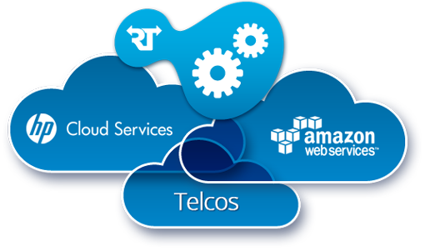
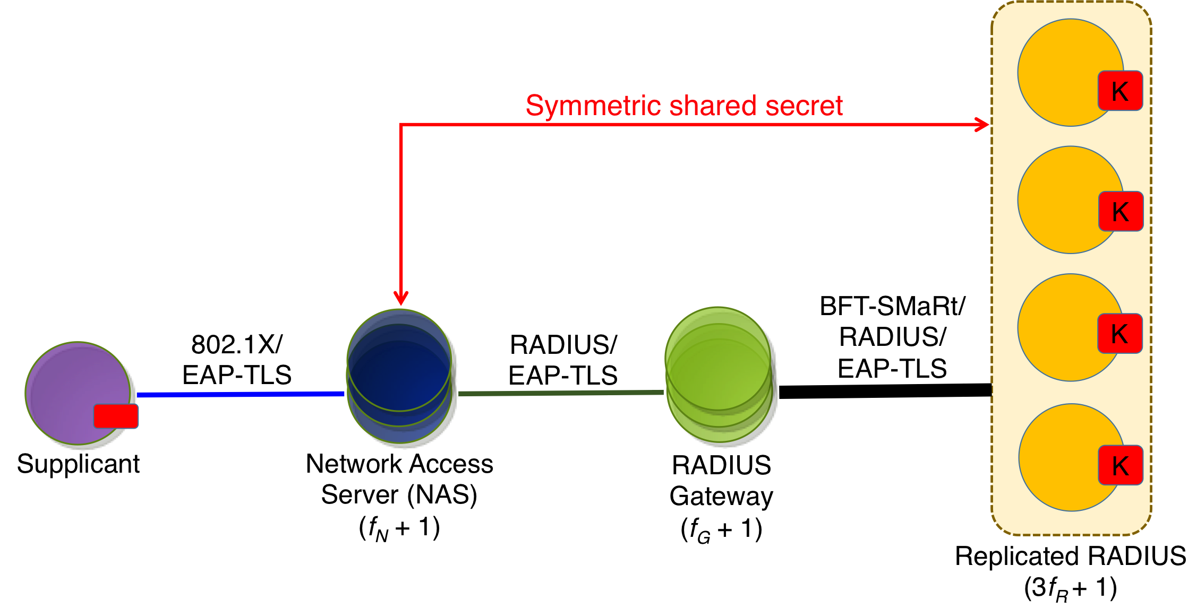


How to achieve our goals?
Approach 2: increase the system’s security and dependability
Hybrid system architectures, specialized components, clouds, …
Notes:
Falar quase nada do paper

Slide 17
Goals
Develop new hybrid system architectures for AAIs.
Design & Provide mechanisms for building fault- and intrusion-tolerant AAIs
Notes:
Falar quase nada do paper

Slide 18
Challenges
Arbitrary fault tolerance in AAI systems
Ensure confidentiality of sensitive data
Keep backward compatibility
Notes:
Falar quase nada do paper

Slide 19
Our main contributions
Step-by-step design of resilient AAIs
A novel trusted component for ensuring confidentiality
Experimental evaluation in different environments
Notes:
Falar quase nada do paper

Slide 20
Outline
Goals & Challenges
Our Solution
Intrusion-Tolerant AAIs
Evaluation
Conclusion
Notes:
Cuidar na troca para o prox slide

Slide 21
Traditional RADIUS architecture
Shared secret (confidentiality, integrity)
Shared secret
802.1X
RADIUS
LDAP, SQL
Client
NAS
(e.g., WiFi router)
Authentication
Server
Backend
Service
Notes:
Falar quase nada do paper

Slide 22
Traditional RADIUS architecture
How to avoid single points of failure?
Shared secret
802.1X
RADIUS
LDAP, SQL
Client
NAS
(e.g., WiFi router)
Authentication
Server
Backend
Service
Notes:
Falar quase nada do paper

Slide 23
Building a resilient architecture
‘Multi-path’ by simple replication
Shared secret
RADIUS
LDAP, SQL
802.1X
Client
NAS
(e.g., WiFi router)
Authentication
Server
Backend
Service
Notes:
Falar quase nada do paper

Slide 24
Building a resilient architecture
How to tolerate arbitrary faults?
Shared secret
RADIUS
LDAP, SQL
802.1X
Client
NAS
(e.g., WiFi router)
Authentication
Server
Backend
Service
Notes:
Falar quase nada do paper

Slide 25
Building a resilient architecture
Backward compatibility & SMR integration
BFT-SMR
RADIUS
802.1X
Client
NAS
(e.g., WiFi router)
Authentication
Gateway
Authentication
Server &
Back-end
Notes:
Falar quase nada do paper

Slide 26
Building a resilient architecture
How to ensure the confidentiality of shared secrets?
Shared secret
BFT-SMR
RADIUS
802.1X
Client
NAS
(e.g., WiFi router)
Authentication
Gateway
Authentication
Server &
Back-end
Notes:
Falar quase nada do paper

Slide 27

Building a resilient architecture
Solution = Trusted Components on the RADIUS replicas
Shared secret
BFT-SMR
RADIUS
802.1X
Client
NAS
(e.g., WiFi router)
Authentication
Gateway
Authentication
Server &
Back-end
Notes:
Falar quase nada do paper

Slide 28
Building a resilient architecture
EAP-TLS with BFT-SMR? How can it work?
Shared secret
BFT-SMR
RADIUS
802.1X
Client
NAS
(e.g., WiFi router)
Authentication
Gateway
Authentication
Server &
Back-end
EAP-TLS
Notes:
Falar quase nada do paper

Slide 29
Building a resilient architecture
Progressive and deterministic PRF
seed = HMAC-MD5(secret, seed)
Shared secret
BFT-SMR
RADIUS
802.1X
Client
NAS
(e.g., WiFi router)
Authentication
Gateway
Authentication
Server &
Back-end
EAP-TLS
Notes:
Falar quase nada do paper

Slide 30
Building a resilient architecture
Let’s simplify by removing the back-ends
Shared secret
BFT-SMR
RADIUS
802.1X
Client
NAS
(e.g., WiFi router)
Authentication
Gateway
Authentication
Server &
Back-end
EAP-TLS
Notes:
Falar quase nada do paper

Slide 31
Sensitive Data & Trusted Component
Notes:
Falar quase nada do paper

Slide 32
Sensitive Data & Trusted Component
Notes:
Falar quase nada do paper

Slide 33
Sensitive Data & Trusted Component
Notes:
Falar quase nada do paper

Slide 34
Sensitive Data & Trusted Component
Notes:
Falar quase nada do paper

Slide 35
Sensitive Data & Trusted Component
Method | Protocol | Input | Output
DecryptRSA | TLS | Packet to be verified. | Status of the signature verification.
SignRSA | TLS | Data to sign. | RSA signature using the key PrS .
SymmCipher | TLS/RADIUS | Protocol id and data. | Ciphered output of the input data.
Confidential | TLS/RADIUS | The packet data. | A confidential share of the data.
HMAC | RADIUS | data + encrypted shared key. | HMACMD5 of the input data.
GenAssoc | OpenID | Public key and two big integers. | Association info + server’s public key.
GenNonce | OpenID | Two big integers. | Pseudo random nonce.
Notes:
Falar quase nada do paper

Slide 36
Sensitive Data & Trusted Component
Method | Protocol | Input | Output
DecryptRSA | TLS | Packet to be verified. | Status of the signature verification.
SignRSA | TLS | Data to sign. | RSA signature using the key PrS .
SymmCipher | TLS/RADIUS | Protocol id and data. | Ciphered output of the input data.
Confidential | TLS/RADIUS | The packet data. | A confidential share of the data.
HMAC | RADIUS | data + encrypted shared key. | HMACMD5 of the input data.
GenAssoc | OpenID | Public key and two big integers. | Association info + server’s public key.
GenNonce | OpenID | Two big integers. | Pseudo random nonce.
Notes:
Falar quase nada do paper

Slide 37
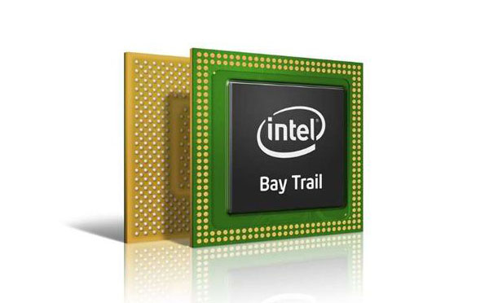
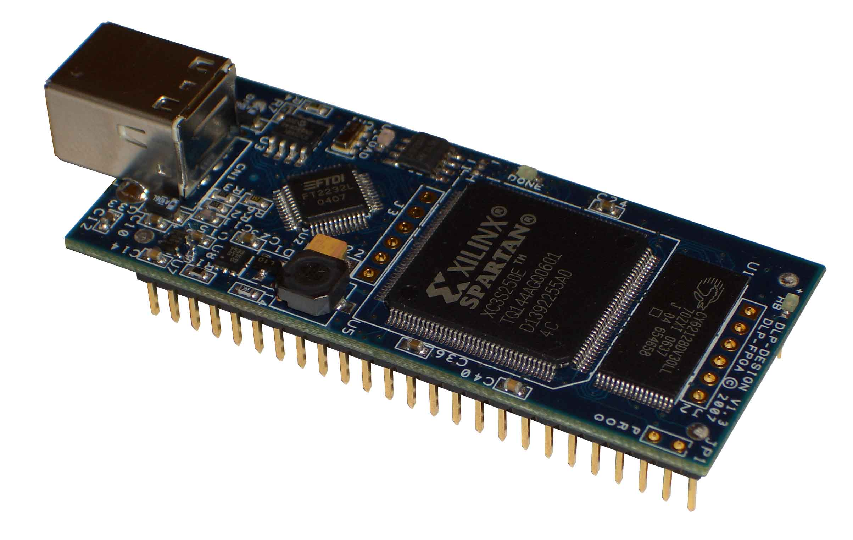

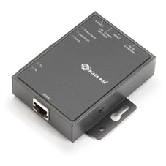
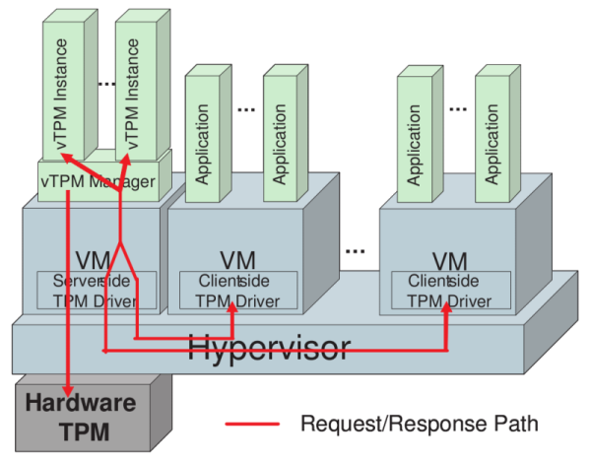
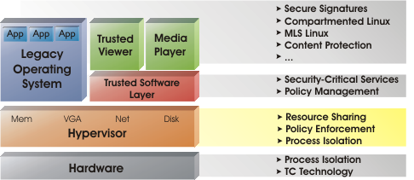

How to implement a trusted component?
A trusted component can be “any” device capable of ensuring the
data and operation confidentiality of the target system/environment.
Smart Cards
Intel SGX
Tamper Resistant a FPGA
A Highly Secured (shielded) Computer
Virtual TPM
(e.g. vTPM)
Secure Hypervisor (e.g. sHyper)
Notes:
Falar quase nada do paper

Slide 38
Generic resilient architecture for AAIs
Suitable for services such as RADIUS, OpenID, Diameter, TACACS+, Kerberos, and so forth.
SMR Protocol
Protocol 2
AAI TCs (mf_{R} + 1)
Protocol 1
Client
Service / Application /
Device
(f_{S} + 1)
Gateway
(AAI front-end)
(f_{G} + 1)
AAI Replicas
(mf_{R} + 1)
38
Notes:
Falar quase nada do paper

Slide 39
Generic resilient architecture for AAIs
Protocol-specific connection between elements
SMR Protocol
Protocol 2
AAI TCs (mf_{R} + 1)
Protocol 1
Client
Service / Application /
Device
(f_{S} + 1)
Gateway
(AAI front-end)
(f_{G} + 1)
AAI Replicas
(mf_{R} + 1)
39
Notes:
Falar quase nada do paper

Slide 40
Generic resilient architecture for AAIs
Protocol-specific shared secrets
Shared secret
SMR Protocol
Protocol 2
AAI TCs (mf_{R} + 1)
Protocol 1
Client
Service / Application /
Device
(f_{S} + 1)
Gateway
(AAI front-end)
(f_{G} + 1)
AAI Replicas
(mf_{R} + 1)
40
Notes:
Falar quase nada do paper

Slide 41
Generic resilient architecture for AAIs
Trusted Third Party (TTP)
Shared secret
SMR Protocol
Protocol 2
AAI TCs (mf_{R} + 1)
Protocol 1
Client
Service / Application /
Device
(f_{S} + 1)
Gateway
(AAI front-end)
(f_{G} + 1)
AAI Replicas
(mf_{R} + 1)
EAP-TLS
41
Notes:
Falar quase nada do paper

Slide 42
Outline
Goals & Challenges
Our Solution
Intrusion-Tolerant AAIs
Evaluation
Conclusion

Slide 43
Resilient RADIUS architecture
Symmetric shared secret
SMR/
RADIUS/
EAP-TLS
801.1X/
EAP-TLS
RADIUS/
EAP-TLS
Supplicant
Network Access
Server (NAS)
(f_{S} + 1)
RADIUS
Gateway
(f_{G} + 1)
Resilient RADIUS
(3f_{R} + 1)
43
Notes:
Falar quase nada do paper

Slide 44
Resilient RADIUS communications
Supplicant
NAS
RADIUS
Gateway
RADIUS
Replicas
Trusted
Components
801.1X
RADIUS
BFT-SMR
BFT
Agreement
EAP-TLS
801.1X
RADIUS
BFT-SMR
BFT
Agreement
EAP-TLS
44
Notes:
Falar quase nada do paper

Slide 45
Resilient OpenID architecture
Service Provider
(Relying Party)
(f_{S} + 1)
Resilient OpenID
Identity Provider
HTTP/HTTPS
OpenID 2.0
HTTP/HTTPS
OpenID 2.0
steps 2, 3 and 6
step 1
SMR/
HTTP/HTTPS/
OpenID 2.0
steps 4 and 5
HTTP/HTTPS
OpenID 2.0
Client/Web
Browser
OpenID
Gateway
(f_{G} + 1)
Resilient OpenID
(3f_{R} + 1)
45
Notes:
Falar quase nada do paper

Slide 46
Resilient OpenID communications
Notes:
Falar quase nada do paper

Slide 47
Outline
Goals & Challenges
Our Solution
Intrusion-Tolerant AAIs
Evaluation
Conclusion
Notes:
Cuidar na troca para o prox slide

Slide 48
Resilient RADIUS vs FreeRADIUS
Environment / Configuration
CPU | MEM | Net
2x4 | 32G | Giga
FreeRADIUS
3 machines
Resilient
RADIUS
7 machines
Notes:
Falar quase nada do paper

Slide 49
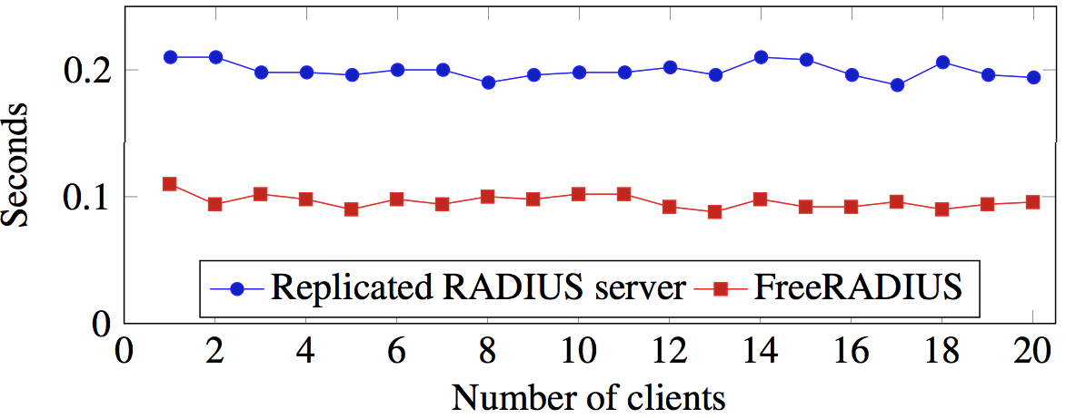
Resilient RADIUS vs FreeRADIUS
Latency
Notes:
Falar quase nada do paper

Slide 50
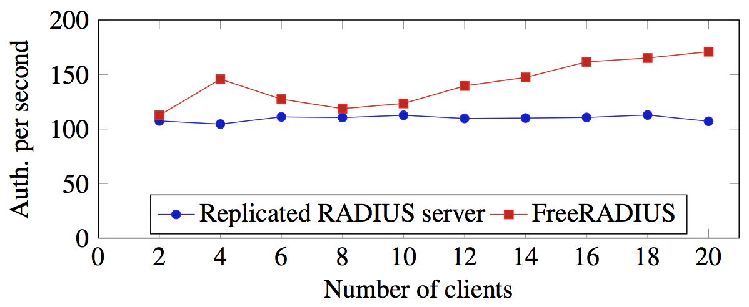
Resilient RADIUS vs FreeRADIUS
Throughput
Notes:
Falar quase nada do paper

Slide 51
Resilient RADIUS vs FreeRADIUS
Fail-stop (crash) and Byzantine faults
Attack | FreeRADIUS | RADIUS Rep | RADIUS Gw
Fail-stop | 9s delay | No delay | 9s delay
Byzantine | Max delay of 9s | No delay | Up to 9s delay
Note: using the default configuration of the RADIUS protocol, i.e., 3s between each retry.
Notes:
Falar quase nada do paper

Slide 52
Resilient OpenID
Environment | vCPU | ECUs | MEM | Network
Cluster-VMsR | 3 | --- | 4GB | Gigabit Ethernet
Cluster-VMsG | 6 | --- | 8GB | Gigabit Ethernet
Cluster-PHY | 16 | --- | 32GB | Gigabit Ethernet
Amazon-DCs | 2 | 6.5 | 7.5GB | Public WAN
Notes:
Falar quase nada do paper

Slide 53
Resilient OpenID
# of authentications/s
Near linear gain
Notes:
Falar quase nada do paper

Slide 54
Resilient OpenID (faults & attacks)
Notes:
Falar quase nada do paper

Slide 55
Outline
Goals & Challenges
Our Solution
Intrusion-Tolerant AAIs
Evaluation
Conclusion
Notes:
Cuidar na troca para o prox slide

Slide 56
A hybrid architecture for intrusion-tolerant AAIs
Notes:
Falar quase nada do paper

Slide 57
A hybrid architecture for intrusion-tolerant AAIs
A new trusted component for ensuring the confidentiality
Notes:
Falar quase nada do paper

Slide 58
A hybrid architecture for intrusion-tolerant AAIs
A new trusted component for ensuring the confidentiality
Backward compatibility for both RADIUS & OpenID
Notes:
Falar quase nada do paper

Slide 59
A hybrid architecture for intrusion-tolerant AAIs
A new trusted component for ensuring the confidentiality
Backward compatibility for both RADIUS & OpenID
Performance assessment and evaluation under fault & attacks
Notes:
Falar quase nada do paper

